Slide 1

IronHack Data Analytics
WEEK 3 | OLYMPICS DATASET
Group 2 - Carles | Rebecca | Angel | Mike

Slide 2

IRONHACK BOOTCAMP DA JAN 31
Agenda
Project Overview
Business Opportunity
Areas of Analysis
Datasets Overview
Data Wrangling and Cleaning
Exploratory Data Analysis
Teamwork & Project Management
Major Obstacles & Lessons Learned
Conclusion and Insights

Slide 3
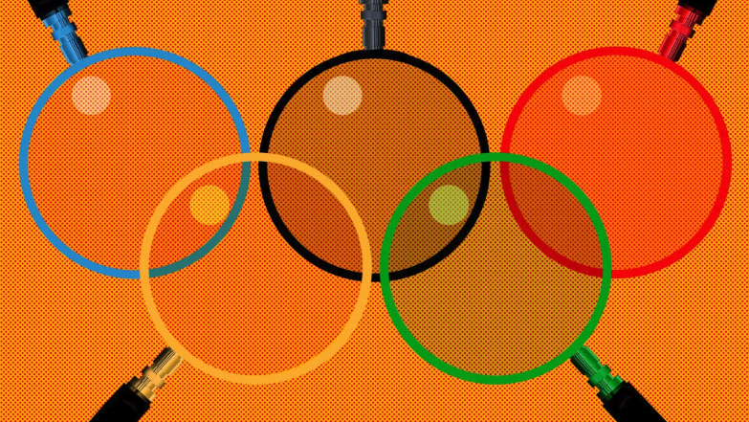
IRONHACK BOOTCAMP DA JAN 31
Project Overview
What influences a country's Olympic success?
This study looks at how economic factors (like a country’s wealth), geographic factors (like being the host country or time zone differences), and sporting factors (like how specialized a country is in certain sports or the age of medal-winning athletes) affect the number of medals won.

Slide 4

IRONHACK BOOTCAMP DA JAN 31
Business Opportunity
Consulting Services for Sport Performance
By understanding the key factors influencing Olympic success, we can offer data-driven consulting services for sports performance optimization.
Value Added:
🥇 For Countries & Sports Organizations:
Benchmark performance against similar nations
Identify key factors to optimize training and resource allocation
🏇 For Betting Companies:
Improve Olympic odds predictions with deeper performance insights
Refine models using economic, geographic, and sporting data trends
📊 Data-driven strategies for better Olympic performance & predictive analytics

Slide 5

IRONHACK BOOTCAMP DA JAN 31
Areas of Analysis
Economic Factors 📈
Hypothesis: Wealthier countries win more medals
Analysis: Comparing a country’s GDP per capita to total country medals
Geographic Factors 🌍
Hypothesis: Athletes from the host country won more medals
Analysis: Change in the number and types of medals won by the host country compared to the previous Olympics
Hypothesis: Efficiency in turning athlete participation into medals will increase in host country
Analysis: Medal performance on conversion rate (Number of athletes winning medals / Total athletes participated)
Hypothesis: Difference in timezone affects athlete performance
Analysis: Comparing the absolute difference in hours between host city and athlete city to total country medals
Sport Factors
Hypothesis: Younger athletes are more likely to win medals
Analysis: Comparing the athlete’s age to their medal performance
Hypothesis: Young medalists are more likely to win again in later Olympics
Analysis: Examining the relationship between athlete age, medal-winning status, and the likelihood of repeat medal success.

Slide 6

IRONHACK BOOTCAMP DA JAN 31
Olympic Dataset
Olympic Games (1896-2016)
Source: Kaggle - Originally scraped from sports-reference.com in May 2018
Shape: 271,116 rows | 15 columns
Strengths
Historical dataset covering the games from 1896 to 2016
Athlete focused:
Each row = One athlete in one event
Includes both medal winners and non-medal winners
Athlete Info: ID, Name, Sex, Age, Height, Weight
Coverage: Very few missing/incorrect values
Weaknesses
Outdated: Does not include data from the 2020 and 2024 olympics
Country Medals: Medals are counted on per athlete basis - inflating the number of total medals won in team sports (e.g. Winning the gold medal in Men’s Football = 22 Gold Medals)
Controversial countries: some countries in our dataset do not exist anymore (i.e: Soviet Union), are not countries (i.e Refugee Team) or there were lack of official information (i.e North Korea or Palestine) → Filter data from 1996 and create a blacklist of countries to not be considered.

Slide 7

IRONHACK BOOTCAMP DA JAN 31
Timezone Dataset
Source: Timezonegenius
Strengths
Easy data to find
Reliable data
Not needed to many changes → just match the name of the cities to our main dataset (Olympic Games 1896-2016))
Weaknesses
Some countries have more than one time zones (i.e: USA, Canada or Russia) → Take into account capital cities time zone in our analysis
Some countries have not whole difference time hour (i.e: India +5.30) → create range to ease the read information

Slide 8

IRONHACK BOOTCAMP DA JAN 31
GDP per capita Dataset
GDP per capita (1992-2023)
Source: World Bank Open Data, Bloomberg & International Monetary Fund (IMF)
Shape: 195 rows | 34 columns
Strengths
Complete dataset with few null values
Same Data Types (except NaN)
Available in the same currency (current US$)
Weaknesses
Hard to fill null values. Some countries have estimations (official sources) for some years instead of the real gdp per capita or
A lot of countries to filter in the sources websites with regions and areas not considered a country (e.g. West Africa, East Asia, or others in our controversial countries list)

Slide 9
IRONHACK BOOTCAMP DA JAN 31
Data Wrangling and Cleaning
Data Wrangling and Cleaning methods
}
Olympic Dataset
Replace NA values as "No Medal" string on Medal column
Duplicated medals per event
Standardize all city names to English
Add ‘regions’ column with Country names
apply.(lambda…)
drop_duplicates
replace
merge
Drop some blacklisted countries
Combine olympic and gdp dataframes
Grouping the countries (to compute the gdp per capita effect as a whole)
}
GDP
drop
merge
groupby
}
drop
merge
apply.(lambda-..)
grouby
map
Timezone
Drop blacklisted countries
Merge podium and time zones files in one
Use function to get time zones ranges
Grouping countries by range and count of medals per range
Massive change in minutes column to be available to sum
functions.py

Slide 10
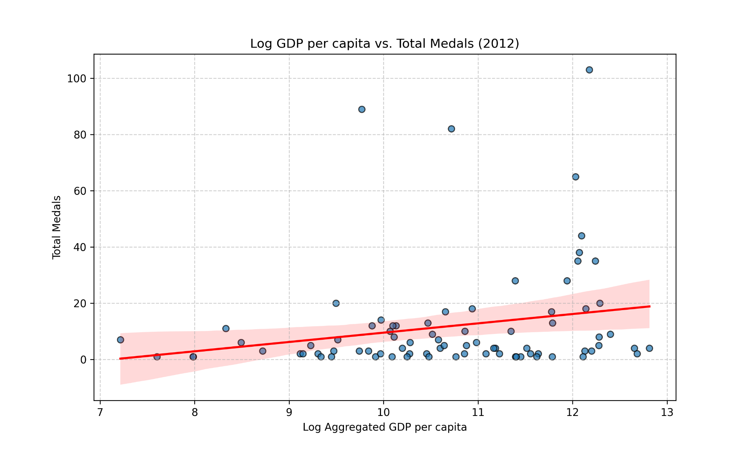

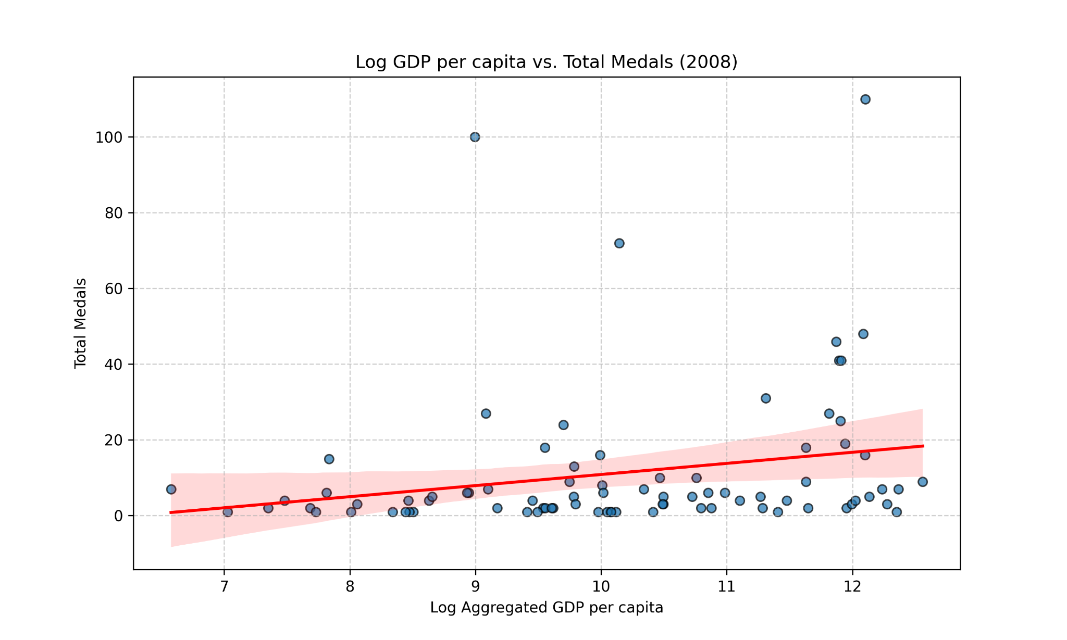
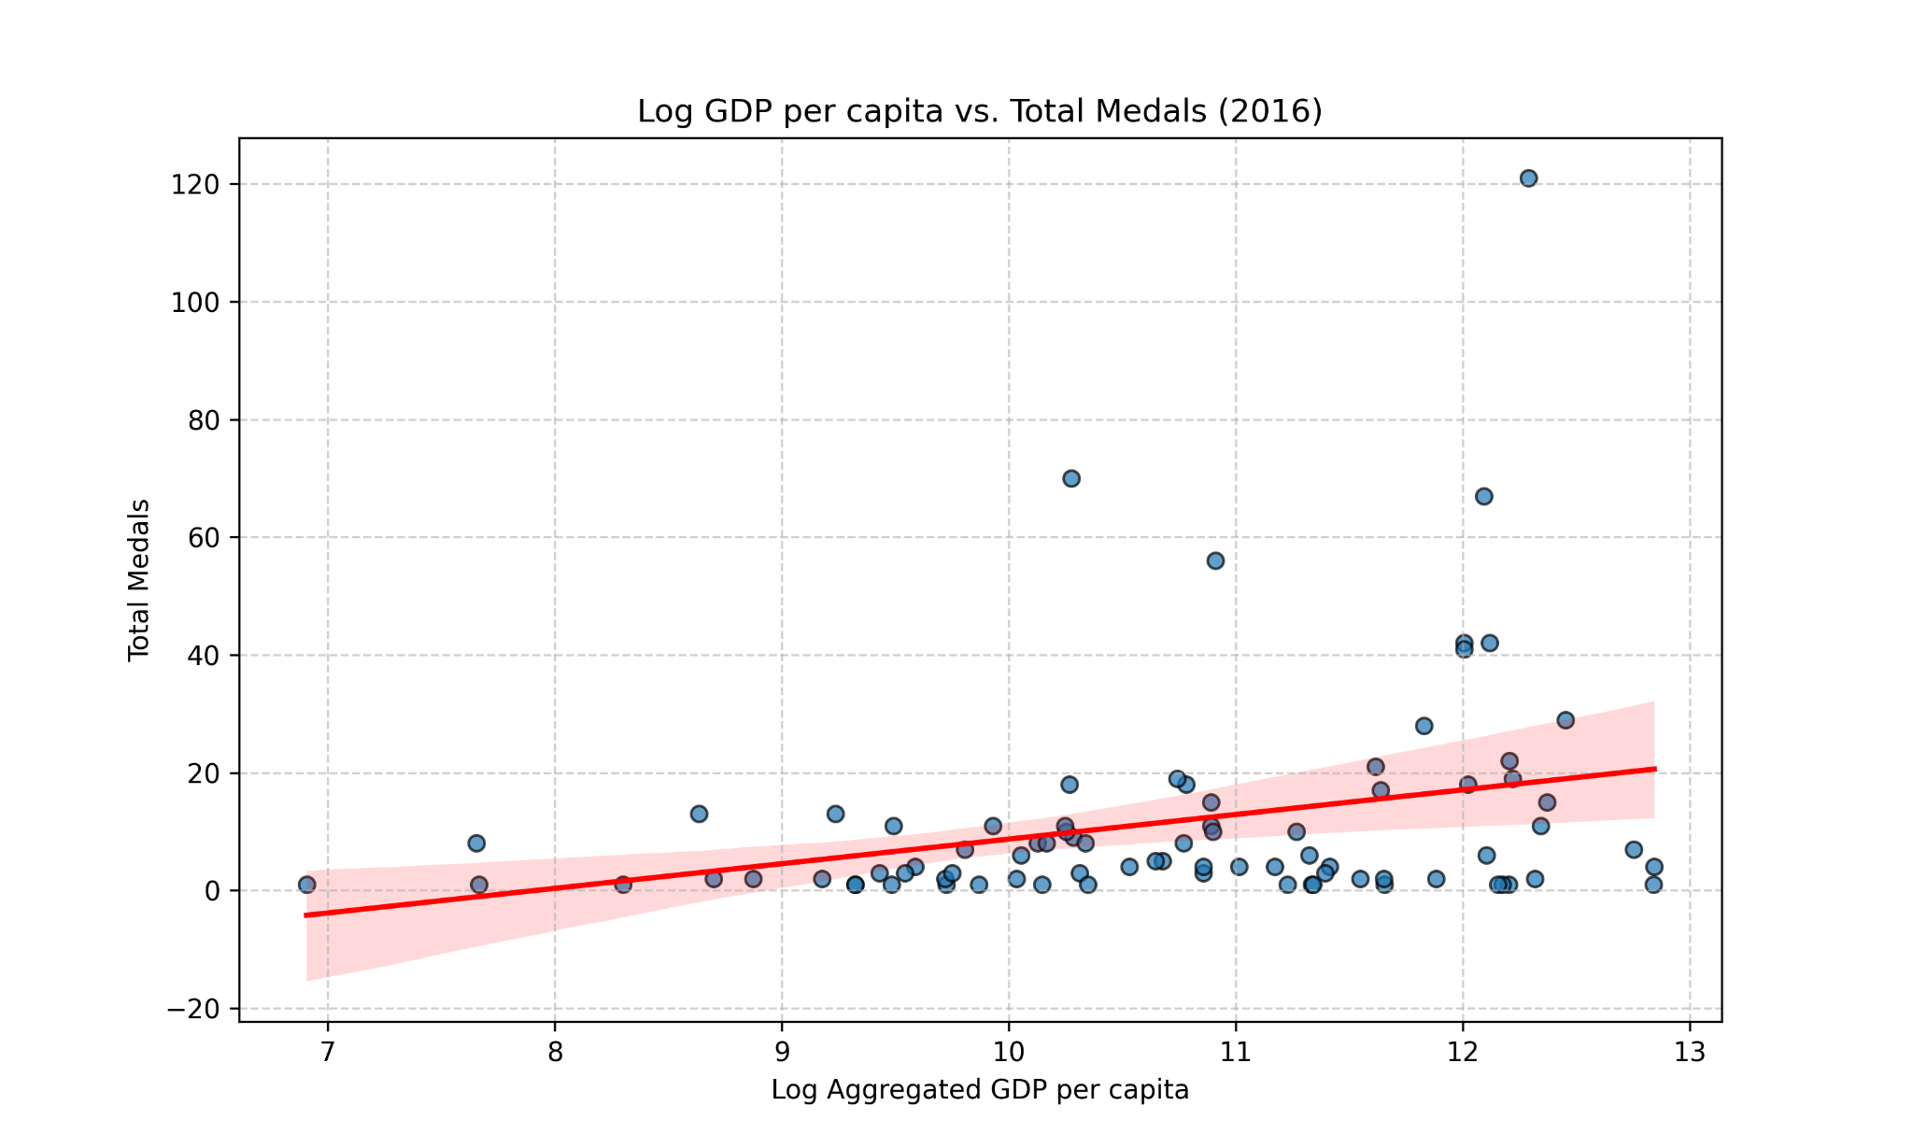
IRONHACK BOOTCAMP DA JAN 31
Analysis: GDP per capita
Hypothesis: “The wealth and resources of a country, can lead to greater investment in sports, better nutrition, and other amenities, thereby affecting the number of medals won”
Correlation: 0.2
There is a low correlation between medals won and the gdp per capita. Although being at either extreme appears to influence performance in terms of the number of medals (with the poorest countries winning few or none), once a certain minimum threshold is reached, further increases in GDP per capita have little or zero impact on the number of medals won.

Slide 11
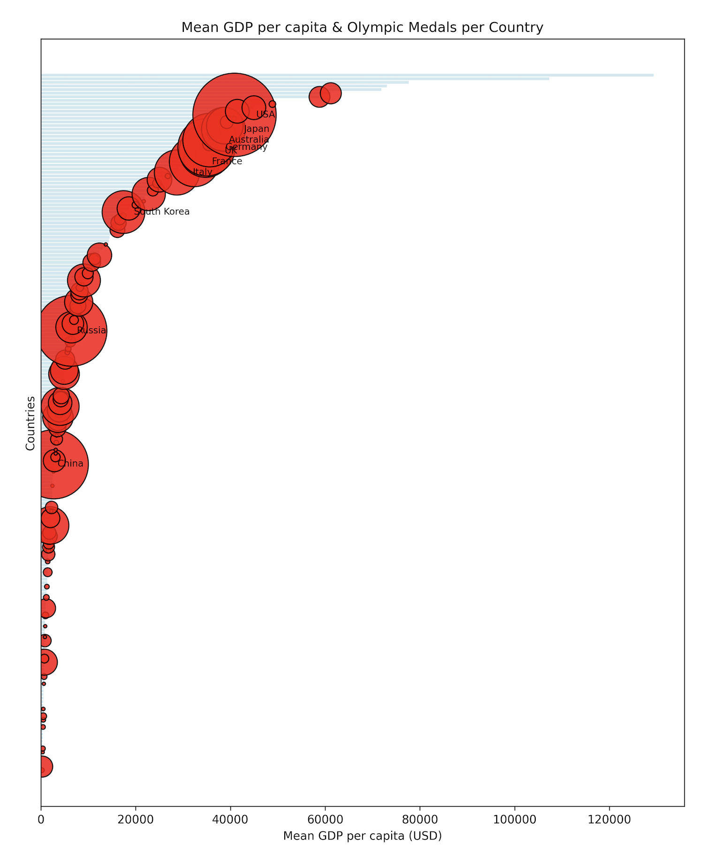
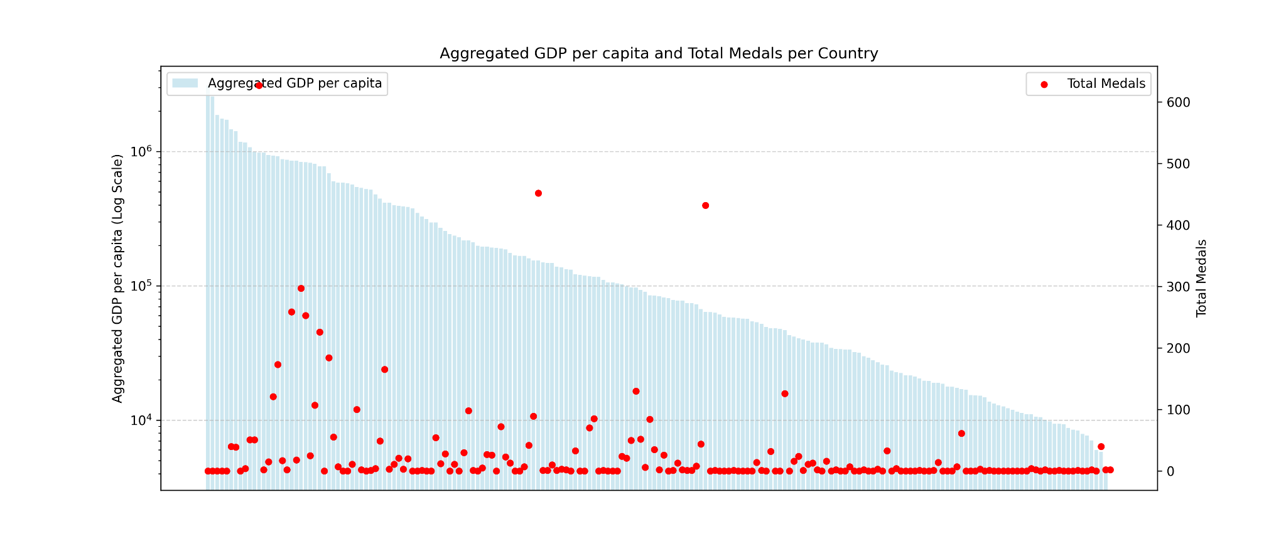
IRONHACK BOOTCAMP DA JAN 31
Analysis: GDP per capita
Hypothesis: “The wealth and resources of a country, can lead to greater investment in sports, better nutrition, and other amenities, thereby affecting the number of medals won”
We can conclude that our hypothesis is false. Although there is some correlation between the number of medals won by the richest and poorest countries, it does not serve as a clear differentiating factor overall.

Slide 12

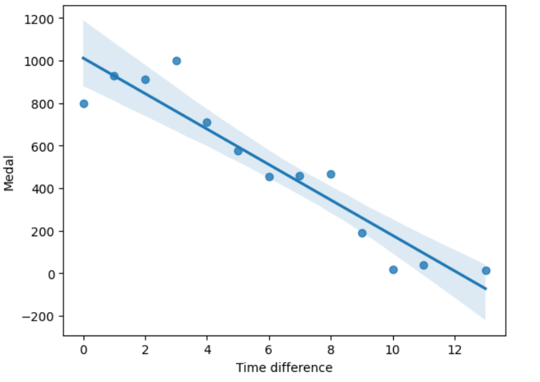
IRONHACK BOOTCAMP DA JAN 31
Analysis: time zones
Hypothesis: “Jet lag or long travels can affect to athletes performance and so as the number of medal won by a country”
Correlation: -0.9
There is a strong correlation between medals won and the difference in time zones. That is, the greater the difference between the hours of the host and athlete city, the fewer the number of medals won by the country.
If we want the predict the odds that a country has to win in the next Olympics, we need to take into account the time difference between the host country and the athlete country.

Slide 13
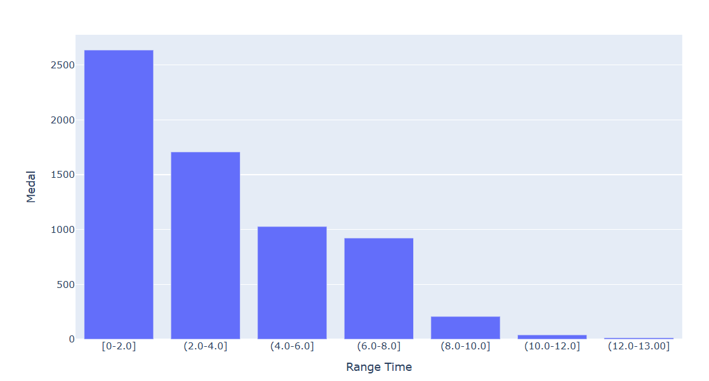
IRONHACK BOOTCAMP DA JAN 31
Analysis: time zones
Hypothesis: “Jet lag or long travels can affect to athletes performance and so as the number of medal won by a country”
We can conclude that our hypothesis is true and the difference of time hours affect on the total number of medals.
As we can see, more than 2,500 medals have been won with a UCT difference of less than 2 hours. This number decreases as the difference grows, showing that countries with a difference between 10 and 13 have barely achieved podiums.

Slide 14

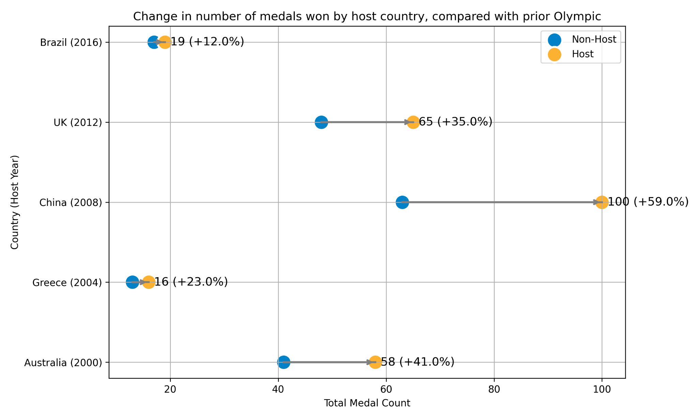
IRONHACK BOOTCAMP DA JAN 31
Analysis: Host Country
Hypothesis: “Athletes from the host country won more medals”
Olympic Games generally leads to an increase in medal count for the host countries compare to previous Olympic year
China’s 59% increase stands out as the most significant (from 63 to 100 medals), reflecting its strong focus on Olympic success.

Slide 15
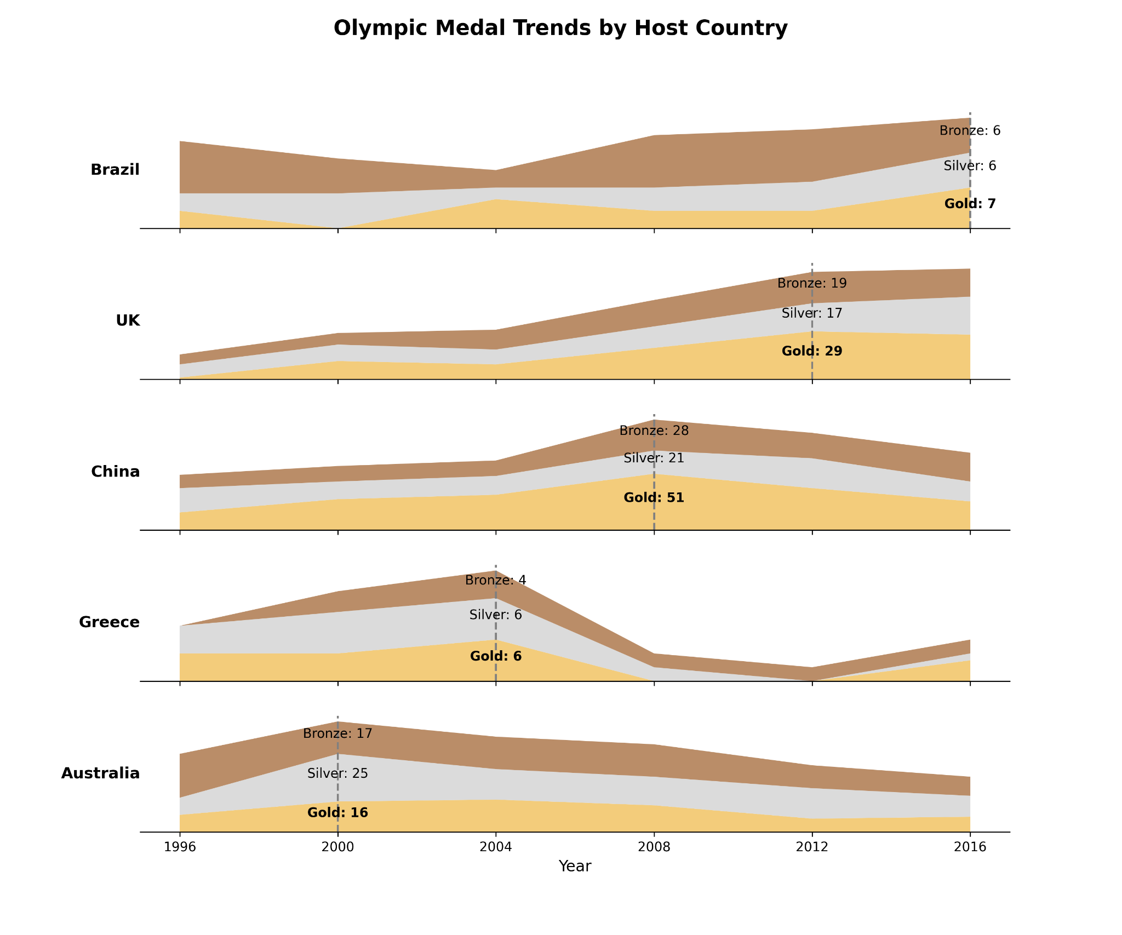

IRONHACK BOOTCAMP DA JAN 31
Analysis: Host Country
Hypothesis:
“Athletes from the host country win more GOLD medals”
The data highlights a clear trend of increased gold medal counts for host countries,
Brazil (2016): Increased from 3 to 7 gold medals, a 133% rise.
China (2008): Increased from 32 to 51 gold medals, a significant rise of 59%.
UK (2012): Increased from 19 to 29 gold medals, a 53% increase.
The findings support that the Olympics is a great opportunity for the host country to enhance its global image, making it more attractive for tourism, investment, and international partnerships.

Slide 16
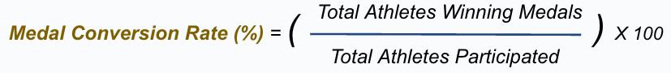
IRONHACK BOOTCAMP DA JAN 31
Analysis: Host Country
Hypothesis:
“Efficiency in turning athlete participation into medals will increase in host country”
Hosting the Olympics is associated with a decrease in the overall medal conversion rate, suggesting lower efficiency in turning athlete participation into medals.
significant decline in Brazil’s medal conversion rate when hosting the Olympics in 2016, dropping from 24.0% to 11.0% (-13.0 percentage points)
Country (Host Year) | Non-Host | Host | Change (pp)
Brazil (2016) | 24.0% | 11.0% | -13.0 pp
UK (2012) | 27.0% | 24.0% | -3.0 pp
China (2008) | 31.0% | 31.0% | 0.0 pp
Greece (2004) | 13.0% | 7.0% | -6.0 pp
Australia (2000) | 32.0% | 30.0% | -2.0 pp
ΔMCR(pp)=MCRHost Year​−MCRNon-Host Year​
Total Athletes Winning Medals​
Medal Conversion Rate (%) = ( ) X 100
Total Athletes Participated

Slide 17
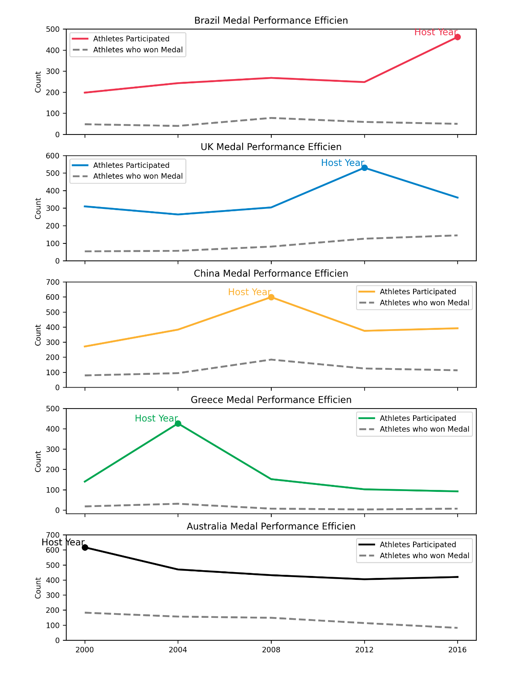
IRONHACK BOOTCAMP DA JAN 31
Analysis: Host Country
Hypothesis:
“Efficiency in turning athlete participation into medals will increase in
host country”
Increased Athlete Participation, Decreased Efficiency: While more athletes from the host nation compete, the medal conversion rate (medals won per athlete) tends to decline during the host year.
Reevaluating Athlete Selection and Support:
Organizations may need to focus on better training and preparation for their athletes. There's a need to refine athlete selection to ensure those competing are best positioned to perform at a high level, rather than simply expanding participation numbers.
ΔMCR(pp)=MCRHost Year​−MCRNon-Host Year​
Total Athletes Winning Medals​
Medal Conversion Rate (%) = ( ) X 100
Total Athletes Participated

Slide 18
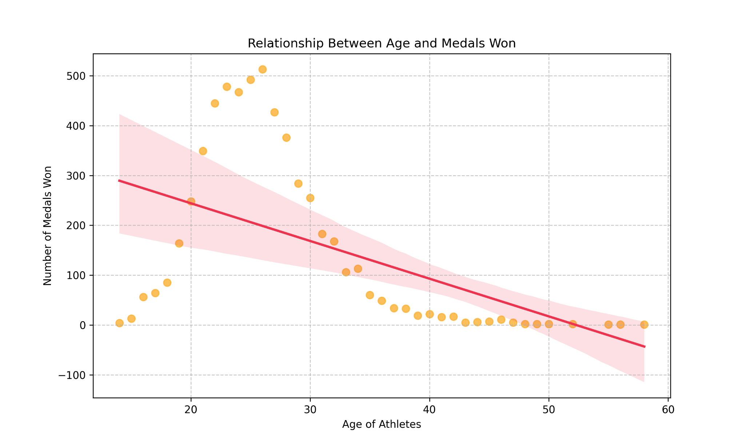
IRONHACK BOOTCAMP DA JAN 31
Analysis: Athlete Age
Hypothesis: “Younger athletes are more likely to win medals”
Correlation, Age and Medal Count: -0.54
Moderate to strong correlation, suggesting that younger athletes have a higher chance of winning medals, while older athletes tend to win fewer.
The median age for Olympic medalists is 25 years old, however, certain sports have younger or older peak ages. For example, Rhythmic Gymnastics peak age is 19 y/o, while Equestrian is 37 y/o.
National Olympic committees and odds makers should favor athletes within the ages 20 to 30 years old to have a higher chance of winning a medal.

Slide 19
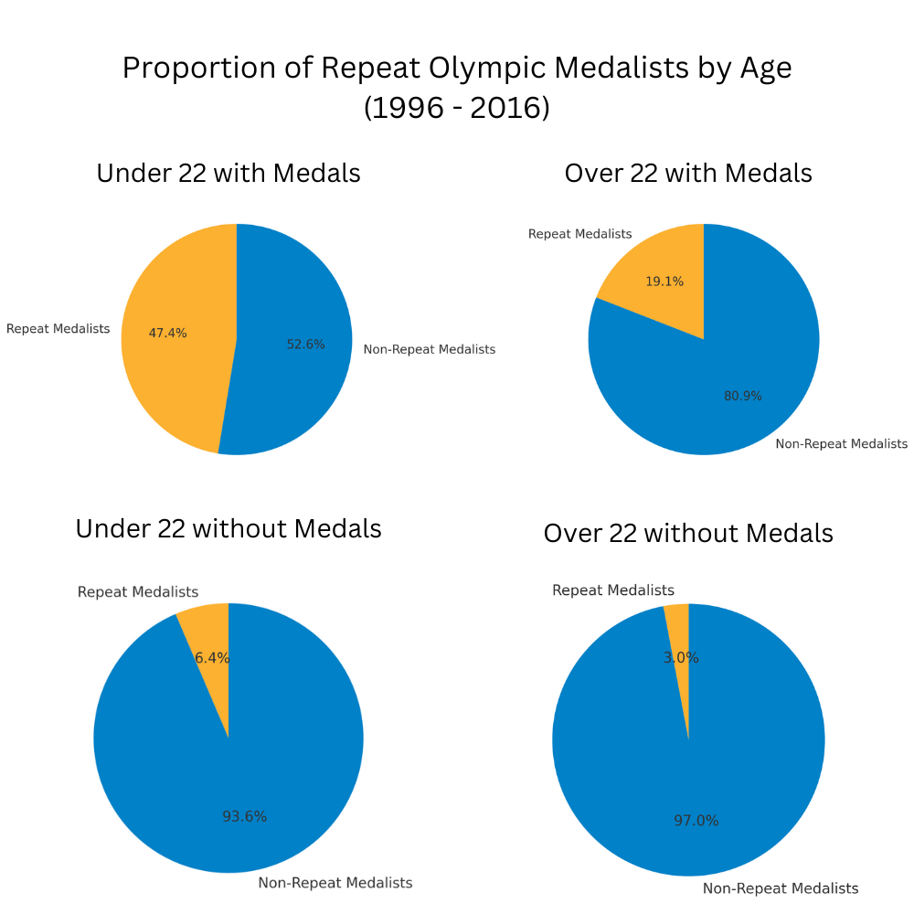
IRONHACK BOOTCAMP DA JAN 31
Analysis: Athlete Age
Hypothesis: “Young medalists are more likely to win again in later Olympics.”
Younger Athletes with Medals Have a Higher Repeat Rate
47.4% of athletes under 22 years old who won a medal went on to win more medals in the following Olympics (4 years later).
This is significantly higher than the 19.1% repeat rate for athletes over 22 years old with medals.
Olympic committees and odds makers should favor young medalists to have a higher chance of winning a medal at the next Olympics.
Notes:
Young medalists are more likely to win again in later olympics
To analyze this, we split the athletes into four categories
Filtered dataset to focus on medalists vs. non-medalists and age groups (Under 22 vs. Over 22).
Calculated total athletes, repeat medalists, and repeat medal percentages for each group.
Pie Charts: Compared the proportion of repeat medalists within different age and medal groups.

Slide 20

IRONHACK BOOTCAMP DA JAN 31
Teamwork & Workflow
Workflow & Adaptation:
Followed our Kanban board workflow, assigning tasks to team members.
Adjusted priorities as needed, especially for tasks that could block others.
What Worked Well:
Daily standups helped keep everyone aligned and updated.
Kanban board & ticket system made tracking progress easy.
GitHub streamlined version control and collaboration.
Areas for Improvement:
Could improve documentation and naming for datasets stored in Github to clearly identify what filters had been applied.
Risk Management:
Used version control (GitHub) to prevent data loss and track changes.
Regular check-ins helped mitigate risks before they became issues.

Slide 21

IRONHACK BOOTCAMP DA JAN 31
Obstacles & Lessons Learned
Obstacle 1: Large & Complex Dataset
Data covered many countries, athletes, and years, with external factors like wars, political changes (e.g., Soviet Union breakup), and missing data.
Challenges: Inconsistent participation, missing economic data, and variations in country representation over time.
How We Overcame It: ↔️ Focused on data from 1996 to 2016 – ensured a more consistent set of participating countries. 😎 Analyzed only Summer Olympics – included more countries with diverse economic, geographic, and cultural backgrounds. ✋ Blacklisted some countries with missing data due to war or political instability.
Lessons Learned:
Narrowing the dataset improved reliability and consistency in our analysis.
Recognizing external factors like political changes is crucial in global sports analytics.
Notes:
Narrowing the dataset improved reliability and consistency in our analysis.
Recognizing external factors like political changes is crucial in global sports analytics.

Slide 22
IRONHACK BOOTCAMP DA JAN 31
Obstacles & Lessons Learned Cont.
Obstacle 2: Defining the efficiency on winning medals
Had to decide how to efficiency on winning medals:
Total medals per country (simplest approach, ignoring the number of athletes participated).
Total medals by sport (only one medal will be counted, not fair for team sport).
Medal conversion rate (taking account for all the athletes who contributed on winning medals).
How We Overcame It: 🥇 Calculated medal conversion rate – how many of a country's athletes win medals compared to how many athletes they send to the competition. A higher rate means more athletes win medals.
📈 Calculated medal performance (efficiency) – helped identify countries that are highly effective in winning medals.
Lessons Learned:
Clarity in defining success metrics is key to ensuring meaningful insights.
Considering different perspectives (e.g., absolute vs. efficiency-based measures) provides a more comprehensive analysis.

Slide 23

IRONHACK BOOTCAMP DA JAN 31
Conclusions & Next Steps
Hypothesis: “The wealthier a country is, the higher number of medals they win.”
Hypothesis: “Jet lag or long travels effect on athletes performance and so as, the number of medals won by a country”
Hypothesis: “Athletes from the host country won more medals””
Hypothesis: “Efficiency in turning athlete participation into medals will increase in host country”
Hypothesis: “Younger athletes are more likely to win medals”
Hypothesis: “Young medalists are more likely to win again in later Olympics.”
Next steps:
Select the variables with high and linear correlation (time zones, host city and young team athletes)
Create a linear regression model to predict the number of models by country taking into account the variables selected.
Sell the model to betting company to increase their odd to win betting.
BE RICH!!!
Us after step 4
Notes:
Insights useful for National Olympic Committees trying to improve their performance
or Betting companies trying to better predict outcomes
Next Steps
Select variables with high and linear correlation
Create a linear regression model and begin training it on our data (70% for training, 30% for testing)
Find more variables with correlation to improve the model
Sell the model

Slide 24

OLYMPICS DATASET ANALYSIS
Carles, Rebecca, Angel, Mike

